Slide 1
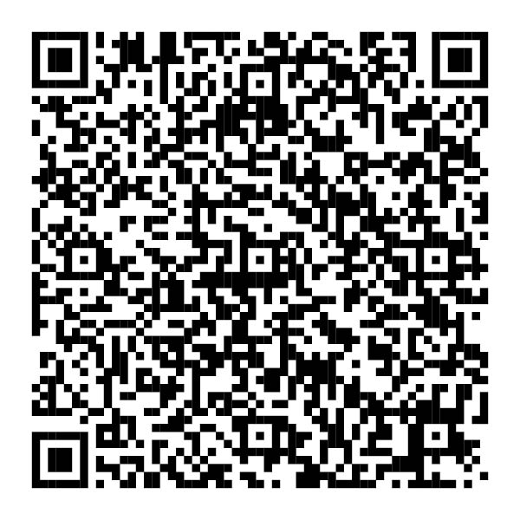








Management Concepts is an established provider of career development, performance improvement, and human capital solutions for the Federal Government.
For over 50 years, Management Concepts has helped Federal Financial Management professionals expand their skills to serve their agencies and to enable both individuals and leaders at these organizations to achieve their goals through federal focused learning, education, and training.
Over 200 Courses Aligned to CFO Council Competencies
Whether new to the field or a seasoned professional, our FM courses and certification programs are aligned to the CFO Council Career Planning and Training Tool (CPTT) competencies. Our up-to-date FM courses are designed to provide every student with the training they require to continue their career journey.
Available How and When You Want
All our FM federally-focused courses are also available via an open enrollment portal – conveniently available via your Government Purchase Card. You can choose between your preferred modality: live in the classroom or virtual live Instructor-led delivery.
2024-2025 Open Enrollment Available Class Sessions
Courses | Domain/Topic Areas | Sessions Available
74 | Financial Management | 750
50 | Leadership & Management | 454
13 | Analytics | 707
95 | Acquisition & Contracting | 139
55 | Project & Program Management | 407
33 | Grants & Assistance | 494
22 | Federal Human Resources | 151
Financial Management Certificate Programs
All Management Concepts courses support earning NASBA and PDU credits.
Federally-Focused Value
Recognized in the Federal Training Space, all our training, available through the GSA CPTT portal, is developed by current and former federal professionals for federal professionals, so students will explore key topic areas with pinpoint precision and relevance. We can also customize or tailor training for private groups.
Easy to Access
We work with federal agencies to make it easy to get training, providing budgetary savings for organizations related to learning funding, with our Unlimited Training Plans and Volume Discount Programs call 833.578.8466.
Guaranteed to Run (GTR) Open Enrollment Sessions Available Weekly
For Private Group Training options, call 800.506.4450.
ManagementConcepts.com

Slide 2
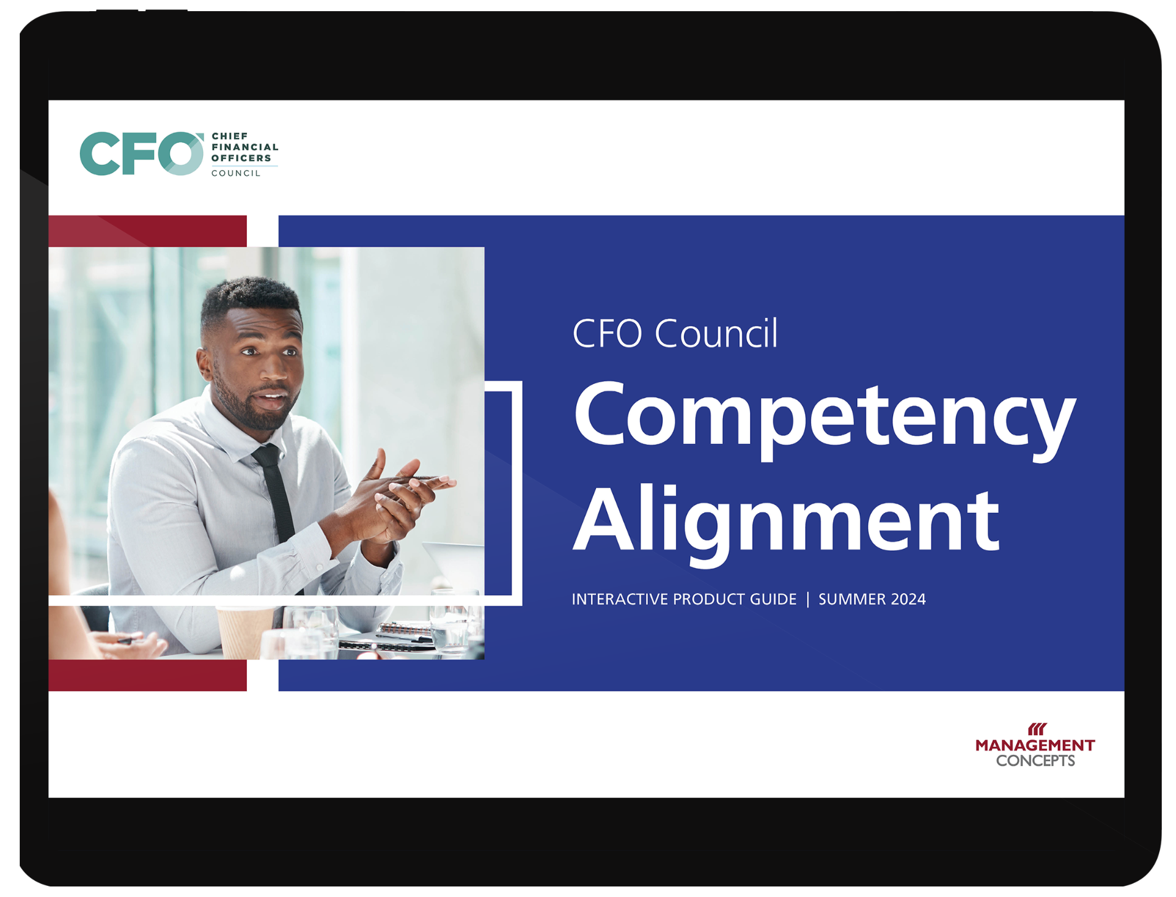
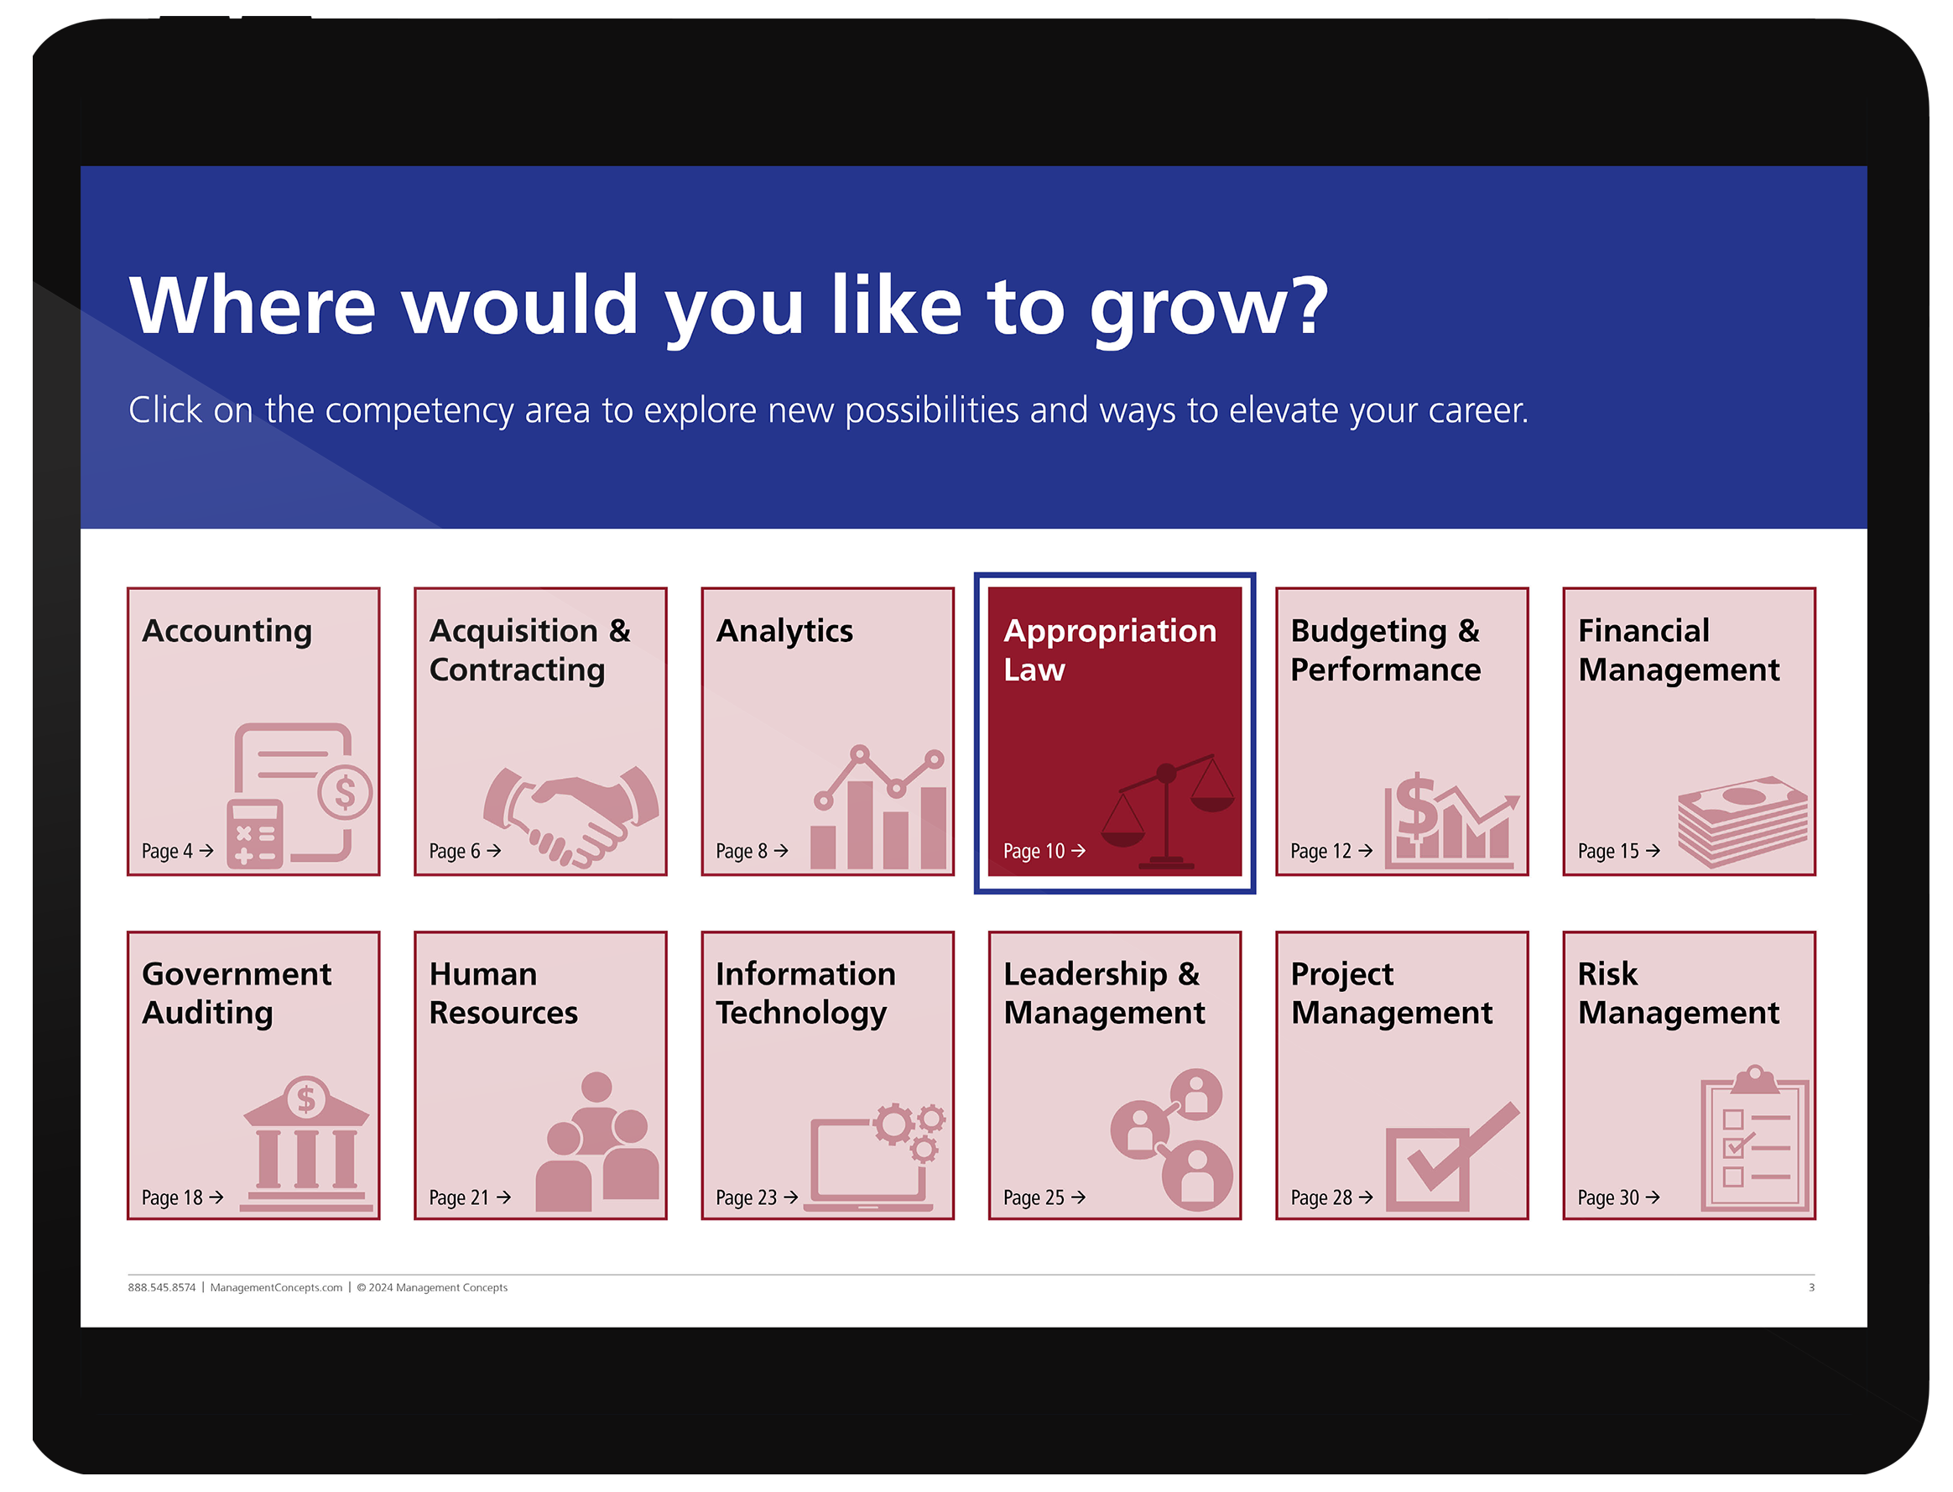
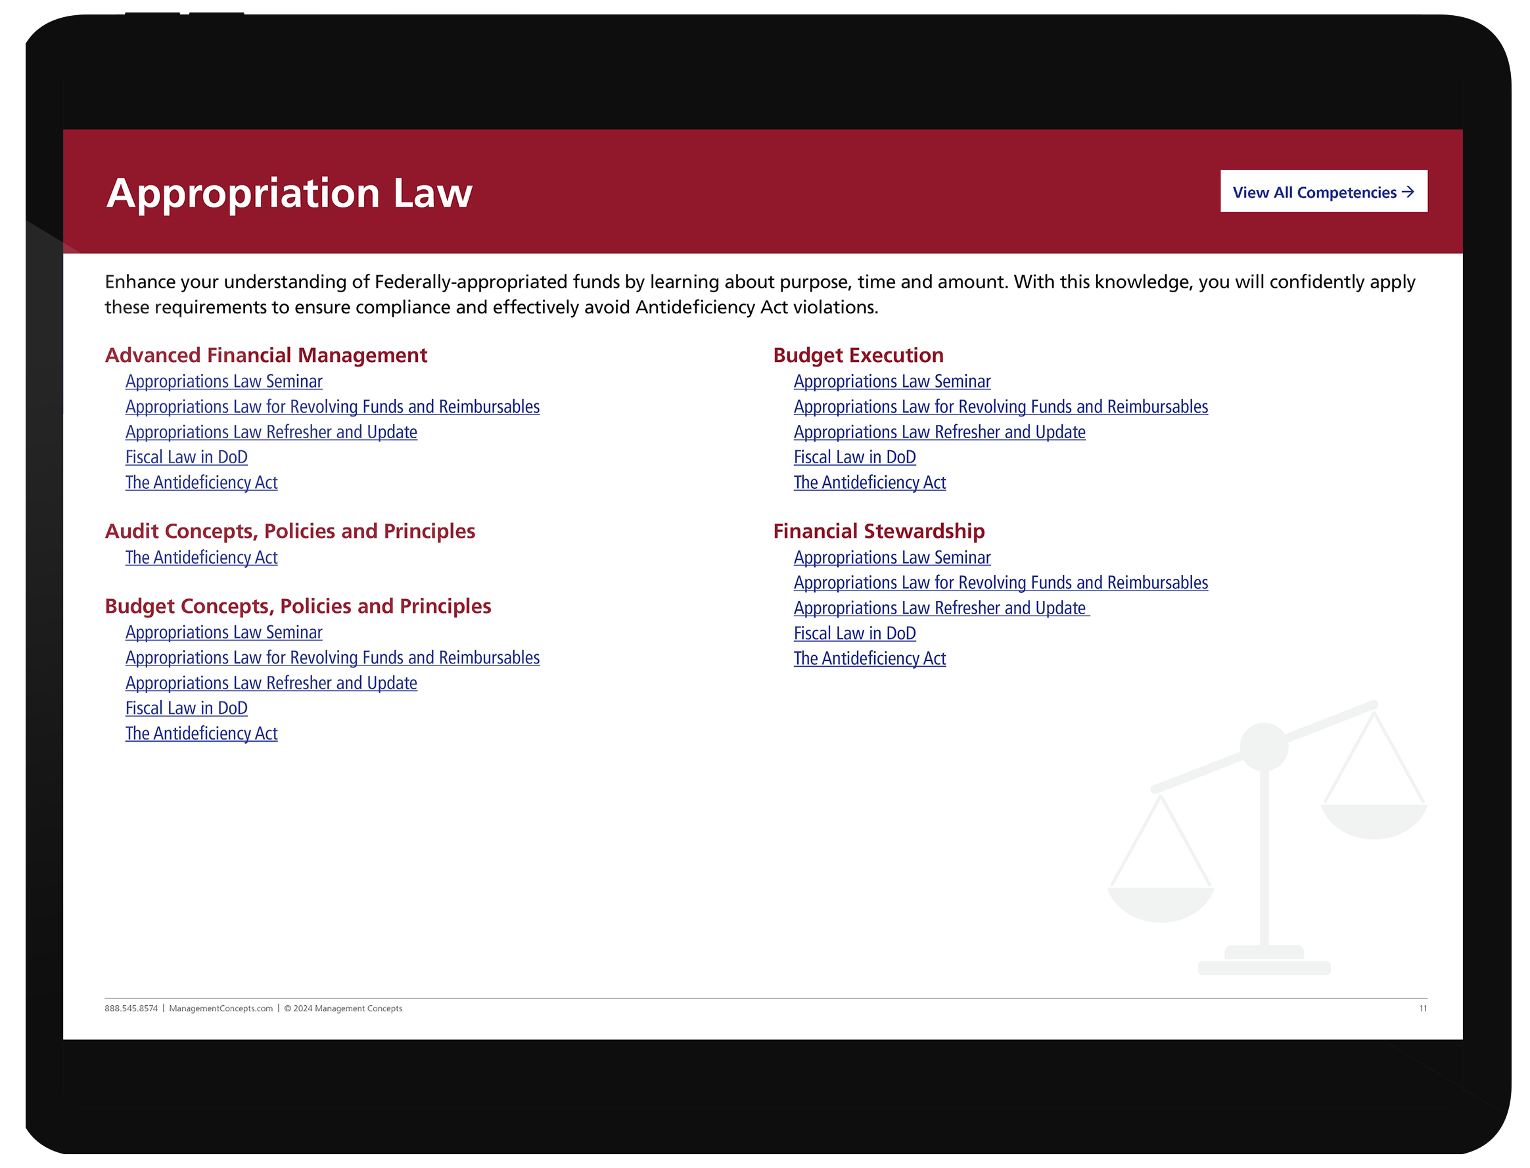
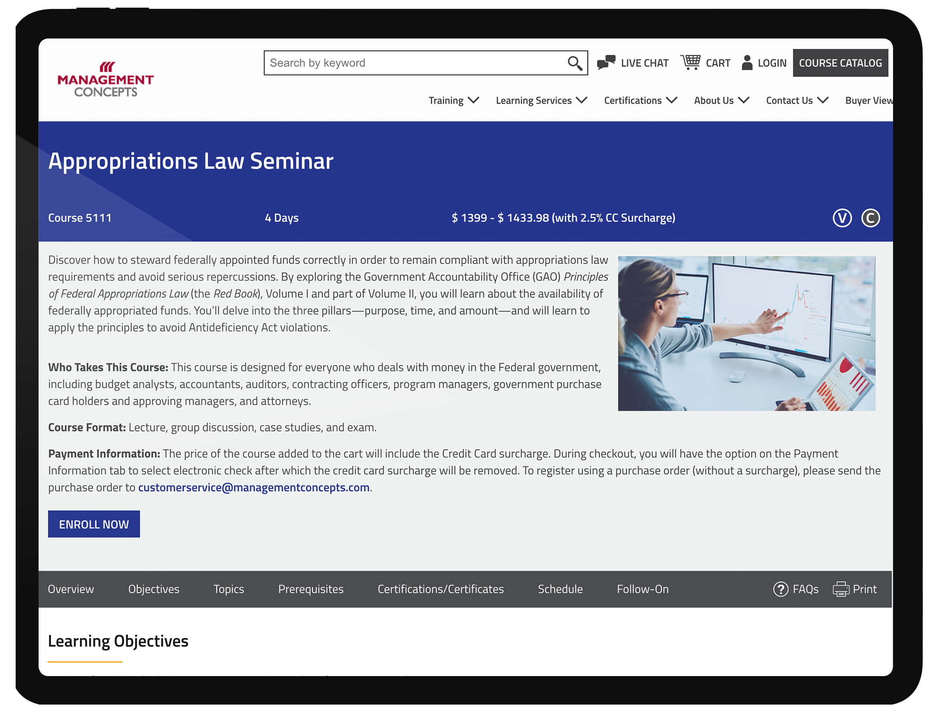
Hundreds of MC Courses Aligned to CFO Council CPTT
Navigating to your desired course is quick and easy.
STEP 1:
Visit Us!
Scan the QR Code to explore our CFO Council-Aligned Courses.
STEP 02:
Find your focus area
Aligned courses are organized by Competency Area.
STEP 03:
Find your desired competency
Each Competency Area has CFO Competencies clearly identified.
Within each Competency, you’ll find the courses you need.
STEP 04:
Find your course
MC offers hundreds of aligned courses that address skills that the federal FM professional needs.
Guaranteed to Run (GTR) classes available weekly.
ManagementConcepts.com

